Slide 1

Enhancing Security for Mid Size E-Commerce
W10D5 Assignment presentation by Max Daguste

Slide 2
Table of Content
Glossary
Key Definitions for Non-Technical Audience
Introduction
Purpose and Scope of the Report
Current Security Landscape
Existing Security and Identified Risks
Security Architecture Goals
Business Requirements and Compliance
Security Architecture Recommendations
Key Security Enhancements
Implementation Strategy
Phased Approach to Implementation
Conclusion
Key Findings and Recommendations
References
Sources

Slide 3
Glossary
Firewall: Think of a firewall as a digital security guard for your computer network. It decides who or what is allowed to enter or exit your network, just like a gatekeeper for your home. Having only one firewall is risky because if it fails, your whole network could be vulnerable.
Network Segmentation: Imagine dividing your network into different rooms, each with its own lock. This helps keep different parts of your network separate and ensures that if one part is compromised, it's harder for attackers to access the rest.
Encryption: Think of encryption as a secret code for your data that only the right people can understand. It's like putting your important information in a locked safe. It keeps your data safe from prying eyes.
Access Controls: Access controls are like special badges that decide who can enter certain areas or access specific information. They make sure only the right people get in and keep out anyone who shouldn't be there.
Security Patch: Security patches are like updates for your computer that fix problems. Applying them promptly is like fixing a hole in your fence before someone can sneak through. Delaying patches can leave your system vulnerable.
Web Application Firewall (WAF): Think of a WAF as a bodyguard for your website. It watches over your site and protects it from online attacks, like having an extra layer of security.
Incident Detection: Imagine having alarms and cameras in your house to tell you when something suspicious is happening. Incident detection helps you know when there might be a security problem so you can act quickly.
National Institute of Standards and Technology (NIST) Framework: The NIST Framework is like a guidebook for keeping your online information safe. It gives organizations recommendations and best practices to make their digital world more secure.

Slide 4
Section 1: Introduction
The purpose of this report is to provide a comprehensive overview of the current security landscape, the goals of the security architecture, and a summary of recommendations for enhancing the security posture of the mid-sized e-commerce company under assessment. The scope of this report encompasses a detailed analysis of the existing security infrastructure followed by a set of recommendations to address identified vulnerabilities and mitigate associated risks.

Slide 5
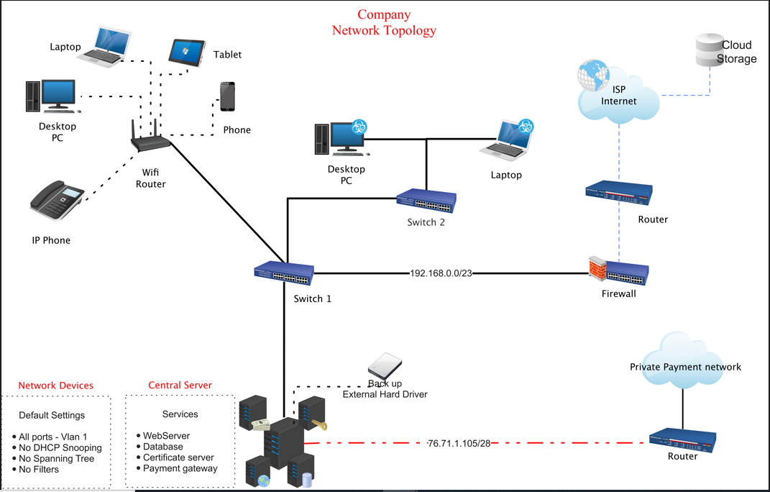
Section 2: Current Security LAndscape
Overview of the e-commerce company's network topology, highlighting critical assets such as payment information, website server, e-commerce website, customer data, and database server.
Identification of vulnerabilities and risks including a single firewall for the entire network, lack of network segmentation, weak encryption, and delayed security patching.
Emphasis on the urgency of addressing these issues to protect customer data, financial transactions, and the company's reputation.

Slide 6
Section 3: Security Architecture Goals
Network Security: Implement redundant firewalls to eliminate the single point of failure and introduce proper network segmentation. This ensures that a breach in one area won't easily lead to unauthorized access to others.
- Definition of Redundant Firewall: A redundant firewall is like having a backup security guard for your computer or network, so if one guard gets tired or fails, the other one is ready to protect your data and keep the bad stuff out.
Data Security: Strengthen encryption protocols to protect sensitive customer payment data. Enforce strict access controls, limiting access to authorized personnel only, and conduct regular security assessments to identify and fix vulnerabilities.
Endpoint Security: Apply security patches and updates promptly to protect against known vulnerabilities. Implement a web application firewall (WAF) to filter incoming traffic, and conduct regular security audits for the web server to proactively identify and mitigate risks.
- Definition of endpoint security: Endpoint security is like putting locks on the doors and windows of your computer or device. It helps keep your personal information and data safe by preventing unauthorized access, viruses, and other harmful things from getting in and causing trouble. It's like having a security system for your digital devices to protect them from cyber threats.

Slide 7
Section 4: Security Architecture Recommendations
The following recommendations are provided across various security domains, including the adoption of the NIST framework:
Network Security: Implement redundant firewalls to eliminate the single point of failure and introduce proper network segmentation. This ensures that a breach in one area won't easily lead to unauthorized access to others.
Data Security: Strengthen encryption protocols to protect sensitive customer payment data. Enforce strict access controls, limiting access to authorized personnel only, and conduct regular security assessments to identify and fix vulnerabilities.
Endpoint Security: Apply security patches and updates promptly to protect against known vulnerabilities. Implement a web application firewall (WAF) to filter incoming traffic, and conduct regular security audits for the web server to proactively identify and mitigate risks.
Benefits of Implementing NIST Framework:
Risk-Based Approach: The NIST framework offers a structured, risk-based approach to cybersecurity, allowing your company to focus resources on mitigating the most critical vulnerabilities and threats.
Comprehensive Guidance: NIST provides comprehensive guidance on cybersecurity practices, ensuring that your security measures cover all aspects of your organization's operations.
Regulatory Compliance: The NIST framework aligns with various regulatory requirements, reducing the risk of legal penalties and financial consequences associated with non-compliance.

Slide 8
Section 5: Implementation Strategy
To implement the recommended security measures, including the NIST framework, a phased approach is proposed. Key elements of the implementation strategy include:
Prioritization of Security Enhancements: Identify critical assets and vulnerabilities, prioritizing security measures based on potential impact and risk.
Resource Allocation: Allocate necessary resources, including personnel, tools, and technology, to ensure the successful implementation of security measures.
Phased Approach: Divide the implementation into well-defined phases, starting with high-priority items. This approach ensures manageable and effective deployment while considering business continuity.
Testing and Validation: Rigorously test and validate security measures at each phase to ensure their effectiveness in protecting the organization's assets.
Timelines: Establish clear timelines for each phase, balancing the need for enhanced security with the continuity of business operations.

Slide 9
Conclusion
In conclusion, this report underscores the critical importance of enhancing the security posture of the mid-sized e-commerce company and emphasizes the benefits of integrating the NIST framework. The existing security architecture, characterized by vulnerabilities such as a single firewall and lack of network segmentation, poses significant risks to the organization's operations, customer trust, and regulatory compliance. The recommended security measures, including the NIST framework, are tailored to address these vulnerabilities and align with business requirements, compliance considerations, and future growth plans. It is imperative that the company takes these recommendations seriously and implements them in a phased manner to fortify its security infrastructure, protect critical assets, and safeguard its reputation in the ever-evolving cybersecurity landscape. Implementing the NIST framework will not only strengthen security but also enhance the company's ability to adapt to emerging threats and protect its reputation, customer trust, and financial well-being.

Slide 10
References
https://www.strongdm.com/rbac
https://www.ibm.com/topics/data-security
https://www.onelogin.com/learn/iam#:%7E:text=Identity%20and%20access%20management%20(IAM)%20ensures%20that%20the%20right%20people,each%20app%20as%20an%20administrator.
https://nvlpubs.nist.gov/nistpubs/SpecialPublications/NIST.SP.800-53r5.pdf
https://www.nist.gov/blogs/manufacturing-innovation-blog/creating-culture-security

